Slide 1

Pattern-Based AI Bot for Chess Game
Explore how AI learns chess through pattern recognition. This presentation covers the bot's architecture, training, and performance.

Slide 2
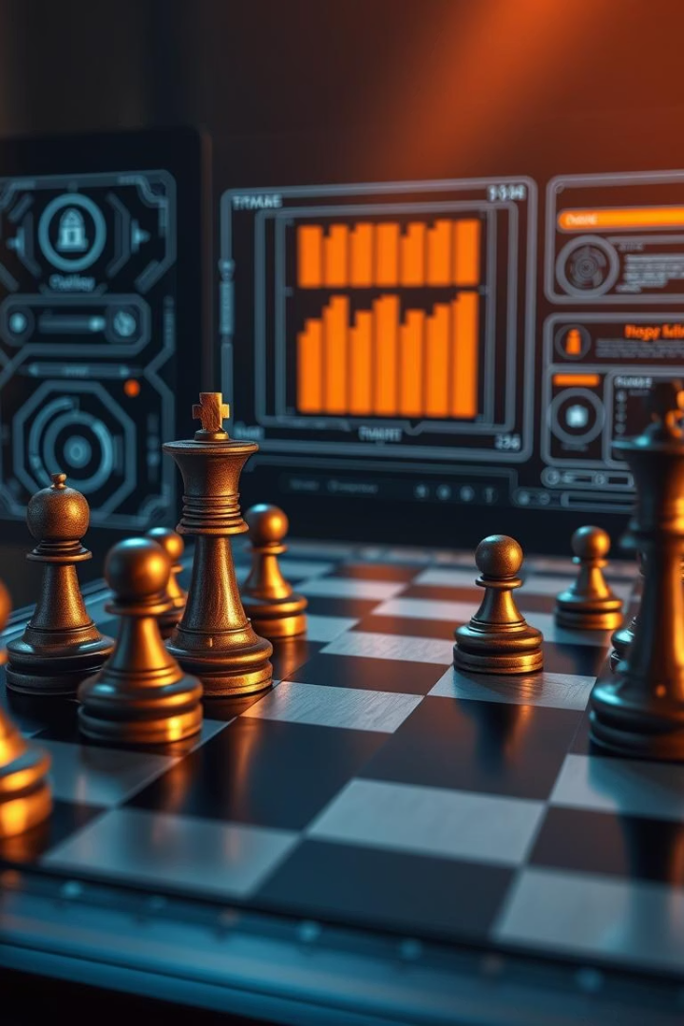
Introduction to the AI Chess Bot
Traditional chess engines
AI-based approaches
Learn patterns and adapt strategies dynamically.
Use fixed rules and brute force search methods.
Challenges
Rule-based systems struggle with complexity and creativity.

Slide 3

Core Concepts: Pattern Recognition
Pattern Recognition
Human Expertise
Detects recurring positions, attacks, and defenses in games.
Top players memorize and rely on patterns for strategy.
Classic Openings
King's Indian Defense
Sicilian Defense

Slide 4
Data Acquisition and Processing
Data Sources
Processing
Over 10 million games from Lichess and Chess.com.
Cleaning, normalization, and feature extraction.
Ensures diverse and rich gameplay patterns.
Piece positions
Pawn structures
King safety

Slide 5




AI Architecture
CNN Input
8x8 board encoded as multi-channel image data.
Channels
Represent pieces, colors, and move history.
Output
Probabilities for possible moves generated.

Slide 6

Training Process
1
Supervised Learning
Trained on historical games using labeled moves.
2
Epochs
10 training cycles for model refinement.
3
Optimization
Adam optimizer with learning rate 0.001 applied.
4
Infrastructure
Training on Google Cloud using NVIDIA Tesla V100 GPUs.

Slide 7



Performance Evaluation
Rank
2
Ranks in top 5% of all engines tested.
Elo Rating
1
Bot achieves 2800+ rating on Lichess platform.
Win Rate
75% success against Stockfish Level 8 difficulty.
3

Slide 8


GITHUB LINK: GitHub
WEB APP LINK : Chess-Ai

Slide 9
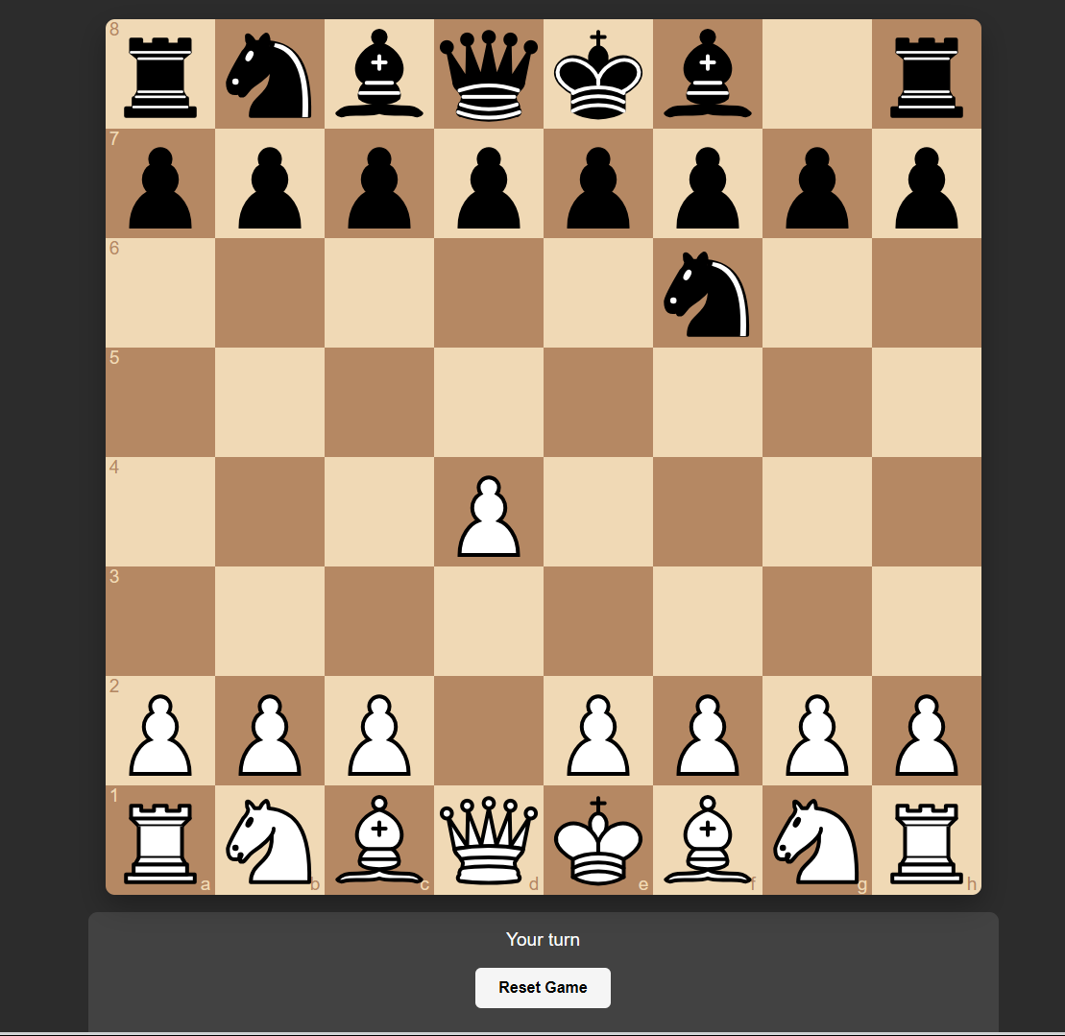

Slide 10
Strengths and Weaknesses
Strengths
Weaknesses
Intuitive, human-like play
High computing power needed
Adapts quickly to opponents
Computational cost limits accessibility

Slide 11
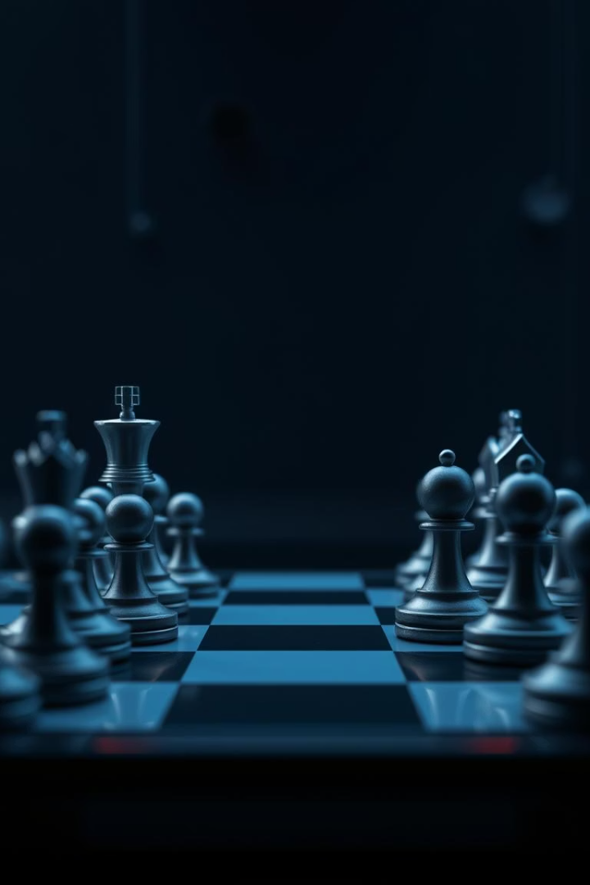
Future Improvements
Reinforcement Learning
Efficiency
Reduce hardware requirements and computational load.
Integrate self-play to enhance strategic depth.
Variants
Explore other chess versions like Crazyhouse.

Slide 12
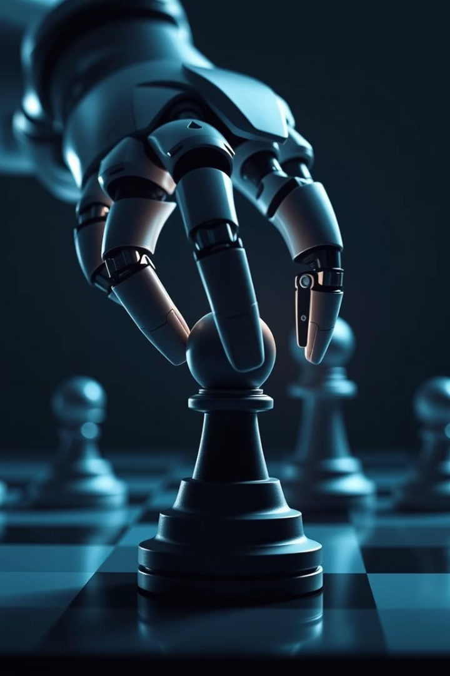
Conclusion
Innovative Approach
Pattern-based AI shows promise in mastering chess.
Game Strategy Revolution
AI empowers new strategic insights and gameplay styles.

Slide 13
THANK YOU

